Slide 1
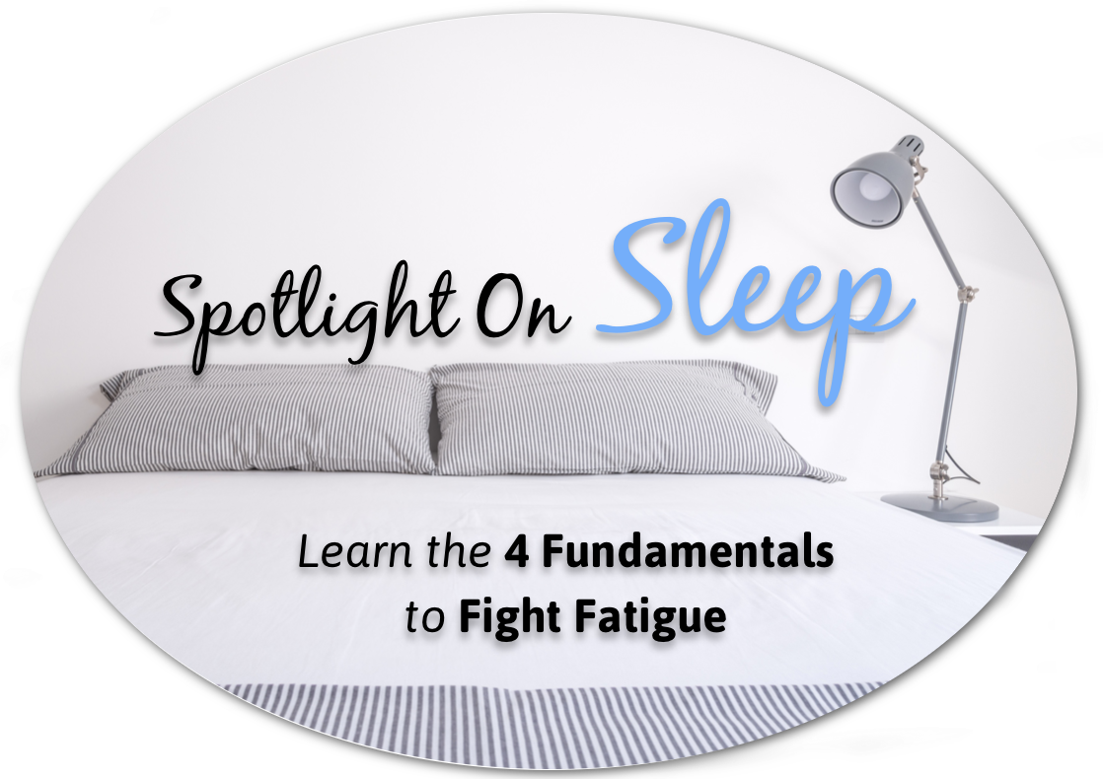
PROSTAID Calgary
August 11, 2015
Chris Carruthers PhD

Slide 2
My Goals for our Time Together
You will:
Take control of how well you sleep.
Know why healthy sleep is essential.
Appreciate the 4 fundamentals of healthy sleep.
Adopt the Top 10 Tips To Sleep Well Tonight.
Practice 3 simple skills to improve your sleep.
Commit tonight to 3 sleep changes.

Slide 3

Your Sleep Self-Assessment
Rate Your Sleep Last Night – 0 is Poor, 10 is Excellent
Rate your Confidence to Sleep Well Tonight

Slide 5

What to Know about Sleep
Sleep is NOT an expendable luxury.
It is critical to our quality of life.
Health changes from improving sleep are much faster than from diet and exercise.

Slide 6
What to Know about Sleep
Sleep is a partially learned behavior, so your commitment to action and practice WILL improve your sleep.
Small actions in each fundamental can result in big changes.
It may be easier than you realize!
6

Slide 7
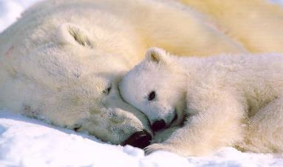
How Important is Sleep?
Rats deprived of all sleep stages will survive only THREE weeks.
Notes:
Rats deprived of REM sleep will survive only 5 weeks, and if deprived of all sleep stages, will survive only 3 weeks.

Slide 8
Why is Sleep Important?
To maximize learning and decision-making.
To enjoy a healthy weight.
To reduce risk of illness and accidents.
To be energized, purposeful, and fulfilled each day.

Slide 9
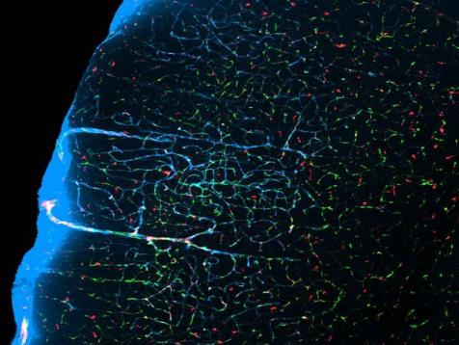
While we sleep, fluid-filled channels of cerebrospinal fluid expand and flush out waste.
Sleep is Brainwashing

Slide 10
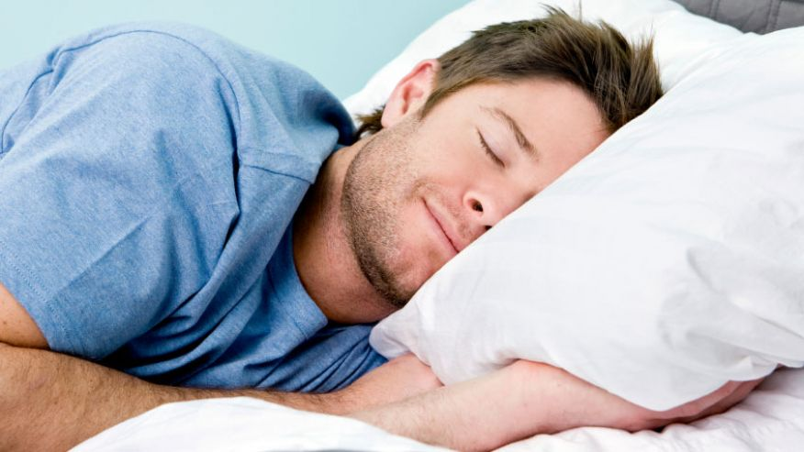
More Sleep Benefits
Undisturbed high-quality sleep is a previously unappreciated mechanism to decrease cancer risk.
                Sleep Medicine Reviews, 2009

Slide 11
More Sleep Benefits
Men with higher levels of the sleep hormone melatonin may be less likely to develop prostate cancer.
Men with low melatonin levels had a fourfold increased risk for advanced disease.
European Urology, 2015

Slide 12

Sacred Sleep and Spirituality
Sleep is time to slow down, notice the quality of our lives, and pay attention to the needs of the body and soul.
Sleep is a bridge to our inner awareness.
Sleep is the opening to our most powerful source of healing; our own spiritual strength.
Use sleep time as a precious resource to reconnect with yourself.

Slide 13

Reflection
What are your driving reasons to improve your sleep?

Slide 14
Reflection
My biggest obstacle to sleeping well is…

Slide 15
The 4 Sleep Fundamentals
Love Your Sleep Environment
Rewire Your Thinking About Sleep
Make Strategic Lifestyle Choices
Learn and Practice Skills to Get to Sleep and Stay Asleep

Slide 16
SET UP A SLEEP ENVIRONMENT THAT YOU LOVE
16

Slide 17


Slide 18
MAKE SMART LIFESTYLE CHOICES THAT TURN INTO SMART LIFESTYLE HABITS

Slide 19



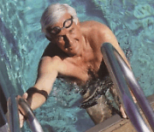


Keep Active

Slide 20

Add Lots of Colour to Your Diet
Notes:
Half-life of caffeine is 5 hours. Do not ingest after 1 or 2 PM.

Slide 21

No television, iPad, tablet, computer, cell phone,
light displays (clocks), or electronics in the bedroom.

Slide 22

True or False?
Caffeine consumed at 6 PM will be cleared through your system by 11 PM.
Notes:
Half-life of caffeine is 5 hours. Do not ingest after 1 or 2 PM.

Slide 23
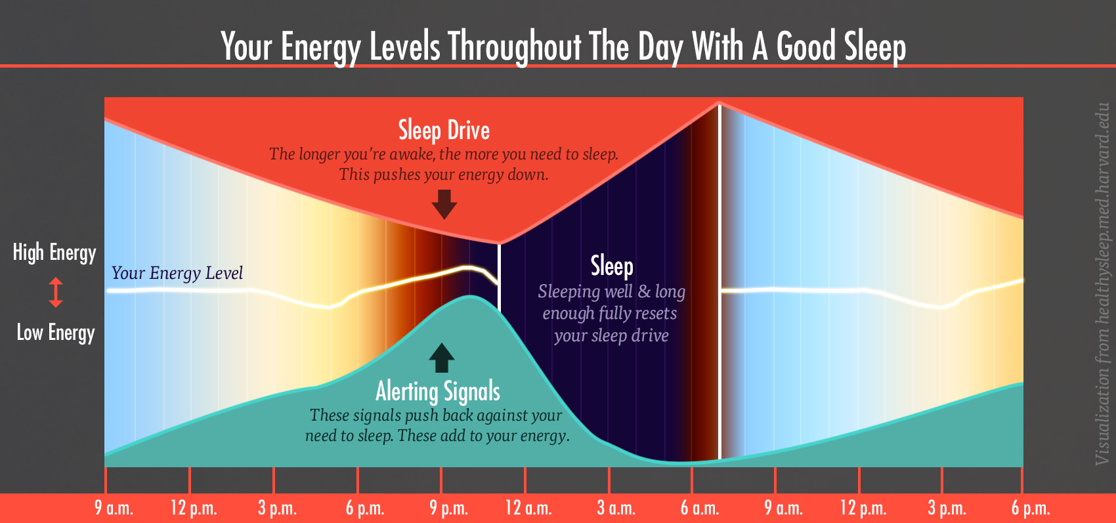

Slide 24
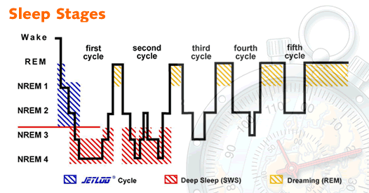
The Stages of Normal Sleep

Slide 25
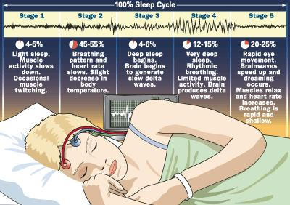

Slide 26
RECOGNIZE THAT YOUR THOUGHTS ABOUT SLEEP IMPACT THE QUALITY OF YOUR SLEEP

Slide 27
Affirmations for sleep
I am drifting into a peaceful sleep.
It is such a pleasure to sleep.
I love resting and nurturing my body.
I am always safe and protected.
I relax knowing that everything looks clearer in the morning.
I am at peace.
The universe is holding me in a warm embrace.
I trust the universe to supply everything I need.
All is well in my world.
27

Slide 28
Learn Three Key Skills to Sleep Well Tonight
Expressive Writing
The 36 Breaths
The Body Scan
28

Slide 29

Skill #1 – Expressive Writing
“What lies behind us and what lies before us are tiny matters compared to what lies within us.”
  Ralph Waldo Emerson

Slide 30
Skill #1 – Expressive Writing
Ideally in evening before bed.
Place your attention gently within.
Explore your thoughts.
No need to solve anything!

Slide 31
PhD Dissertation Research
52 subjects, 17-74 years of age, wide range of health issues, over 8 weeks
56% decrease in common symptoms
24% improvement in mood
Notes:
EW may avoid/defer symptom progression

Slide 32

Skill #2 - The 36 Breaths
Use the power of your mind to relax the body.
Physical tension will float away.
You will come to better understand your wild mind.

Slide 33
Skill #2 - The 36 Breaths
Focus on your breathing.
Count 1 at the completion of one full inspiration/exhalation.
Continue counting to 36.
When you notice you are no longer focused on your breath, notice your thoughts, let them go, and return to a count of 1.
33

Slide 34
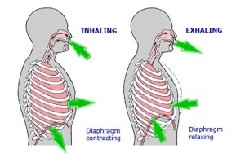
Diaphragmatic Breathing

Slide 35
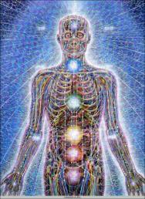
Step 3: The Body Scan
Redirect your mental energy slowly and methodically from top to toe.
Guide your awareness through each body part.
Just notice; don’t analyze or think. Do nothing!
35

Slide 36
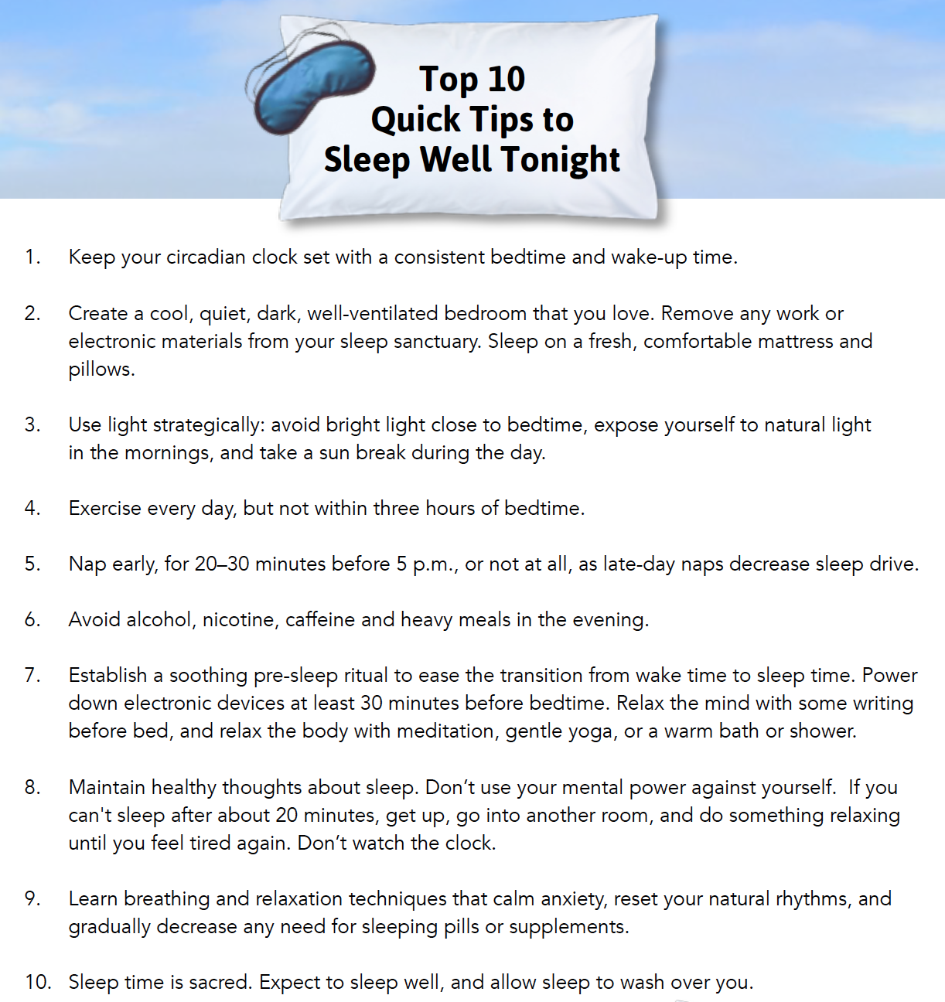
The Top 10 Tips To
Sleep Well Tonight

Slide 37
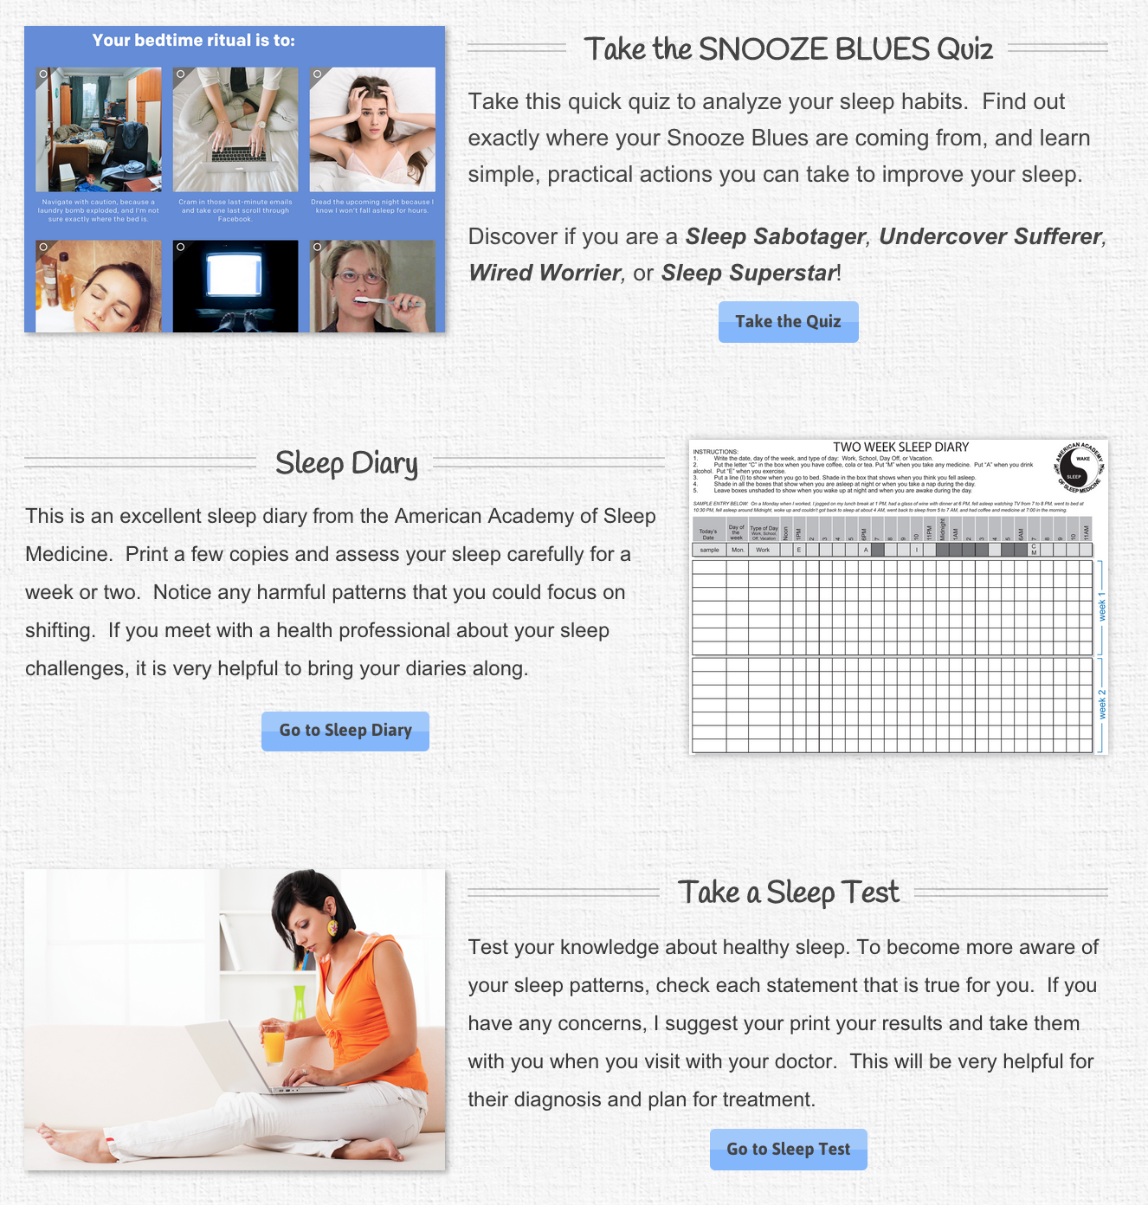
Learning More and Getting Support
www.chriscarruthers.com
Resource Page
  Sleep Diary
  Sleep Quiz
  Recommended Books and Websites
  Free Audio program

Slide 38
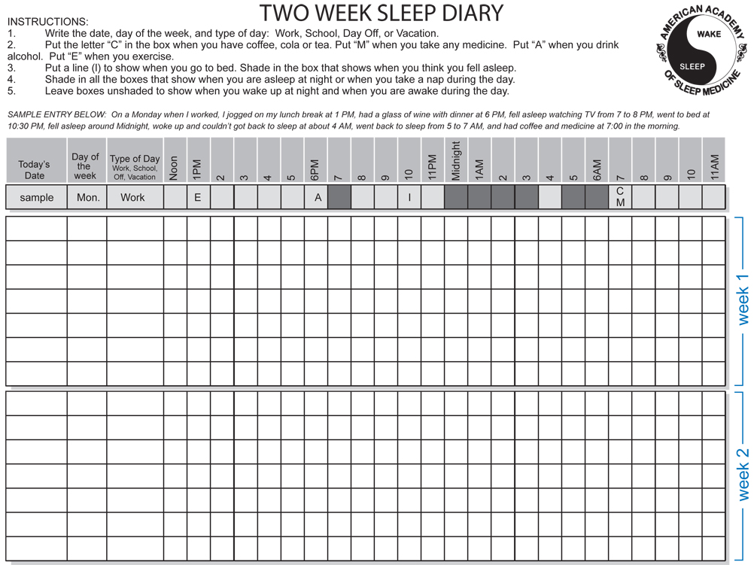

Slide 40
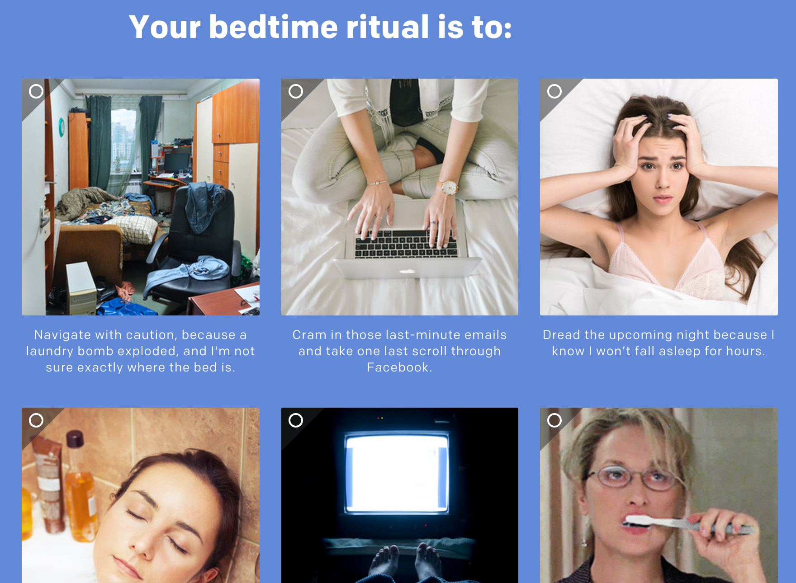
Sleep Quiz

Slide 41
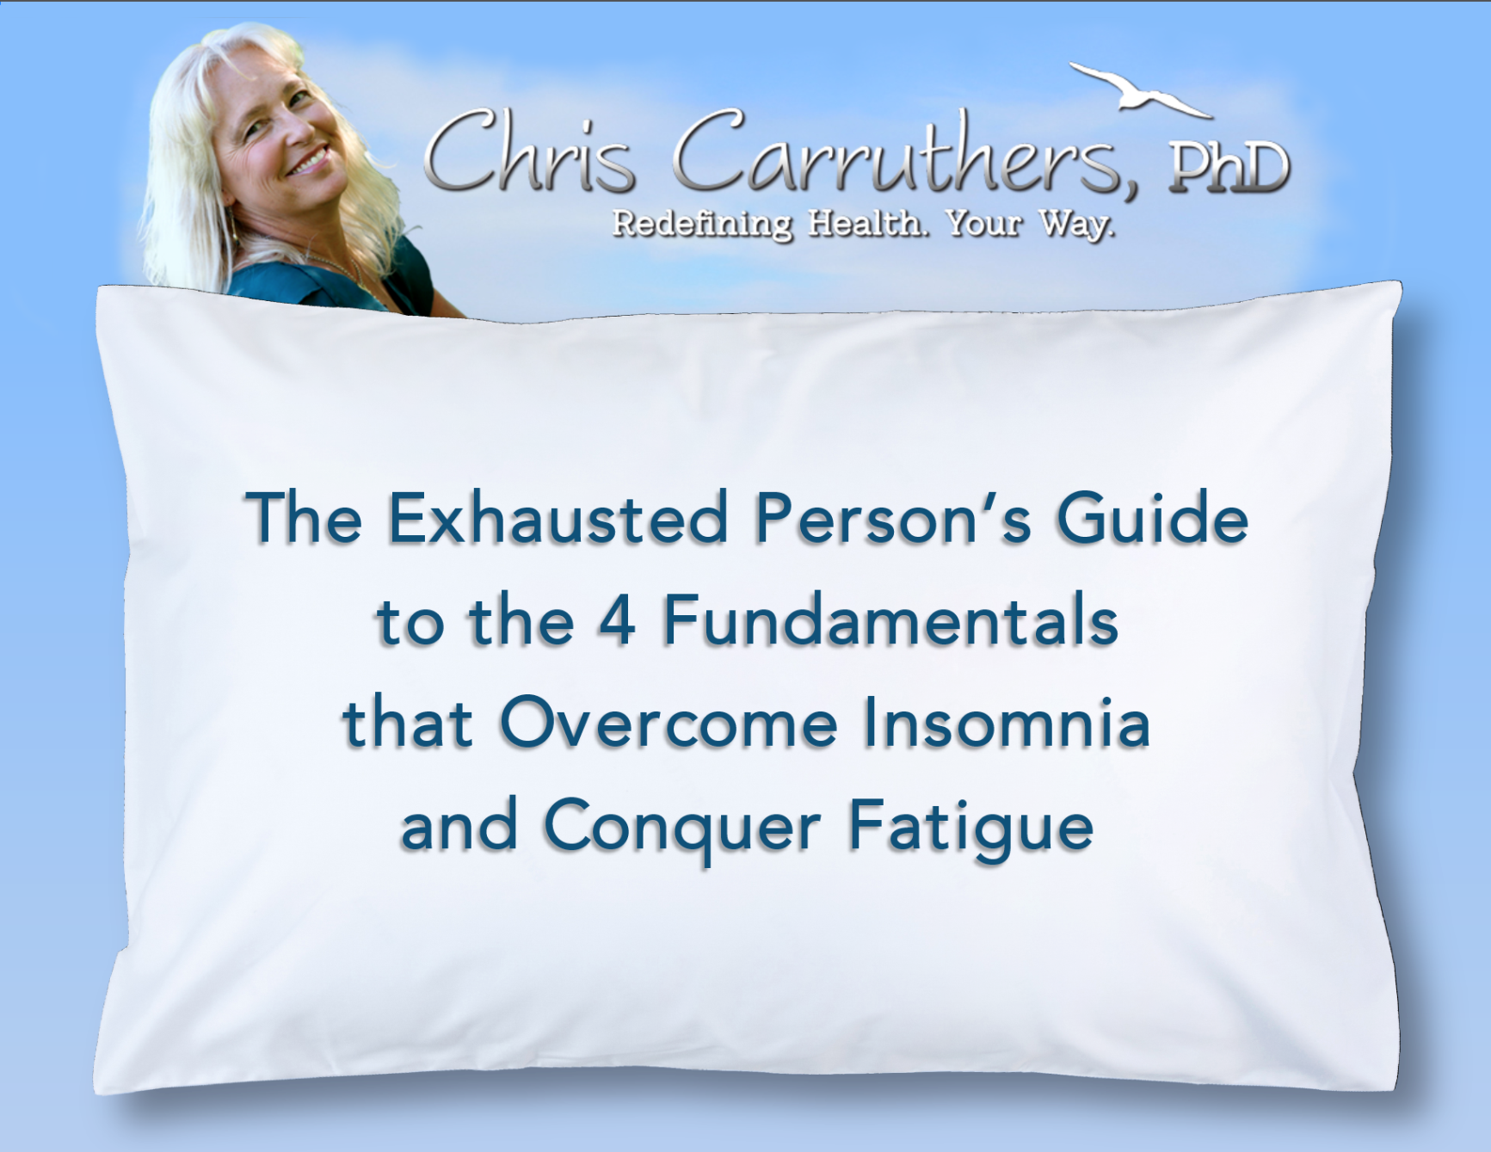

Slide 42

  The Sleep Well Tonight Personal Workbook includes:
  Life Satisfaction Assessment Symptom Checklist
  Your Vision for Health
  Clinical Trials Summary on Sleep and Health
  Your Commitment to Change
  Your Sleep Assessment Quiz
  Your Obstacles to Sleeping Well
  The Three Key Skills: Expressive Writing, The 36 Breaths, The Body Scan
  Your Action Plan Checklist
  Resource List
  Sleep Diary

Slide 43

A 15-Day Sleep Transformation Program That Includes:
  Three 90-minute live, interactive online sessions with myself and the group. Three live Q&A sessions after each webinar.
  15 days of short lessons and reminder tips delivered to your email inbox each day that will help you troubleshoot and apply course insights to real daily challenges.
  Your Sleep Well Tonight Personal Workbook (electronic PDF).
  Sacred Sleep Recommended Resources – my personal sleep resource library.
  Audio-recordings of all 3 webinar sessions for your later review and practice.
  Our 30-day “I gave it my all” money back guarantee.

Slide 44
Receive $75 Off
If You Register By Friday August 14th!
(Details will be sent by email
if you signed up for the draw)

Slide 45

Cognitive Behavioural Therapy (CBT)
Do this FIRST, this is not an add-on
At least as effective as pharmacological therapies for insomnia, but without side effects
Continued benefits 6 – 12 months later
Can improve onset to sleep by 30 minutes, and decrease awakenings

Slide 46
Pharmacology
Despite the lack of evidence, pharmaceutical interventions are widely used by MDs
They don’t provide improved quality of sleep
Safety Issues
  Tolerance
  Abuse
  Dependence
  Withdrawal (rebound insomnia)
  Morning sedation
  Cognitive and motor impairment

Slide 47
When To See A Sleep Specialist
When you feel sleepy during the day, even if you have had a good nights’ sleep.
When you need a long time to fall asleep and wake up frequently.
If you have uncomfortable restless sensations in your arms and legs.
Your legs jerk during the night.
You wake up gasping for breath.
Your partner says your snoring is disrupting their sleep.
You have fallen asleep while driving.

Slide 48
When To See A Sleep Specialist
There are ~88 sleep disorders.
5 most common: insomnia, sleep apnea, restless legs syndrome, narcolepsy, and periodic limb movements.
A polysomnogram of 25 electrodes will assess your brainwaves, hear rate, eye movement, muscle tensing, air flow in mouth and nose, and chest wall movement during sleep.

Slide 49

Your 3 Easiest Next Steps

Slide 50
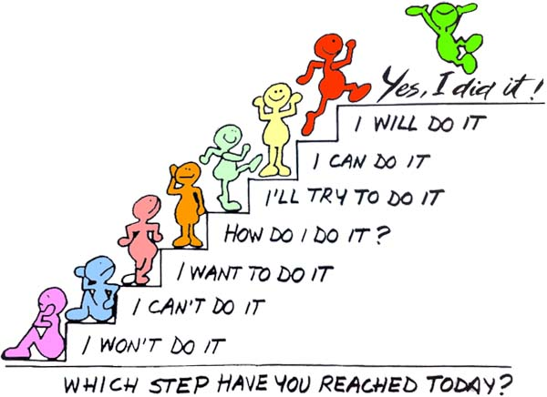
Understanding
Health Behavior Change

Slide 51
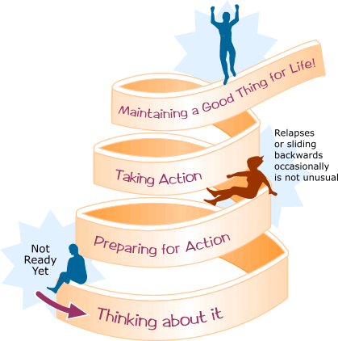
Understanding
Health Behavior Change

Slide 52

Your Commitment To Yourself
Choose 3 changes.
Tell someone about your changes and ask for their support.

Slide 53
Your Sleep Self-Assessment
Rate your Confidence to Sleep Well Tonight NOW!

Slide 54


Questions and Discussion

Slide 55
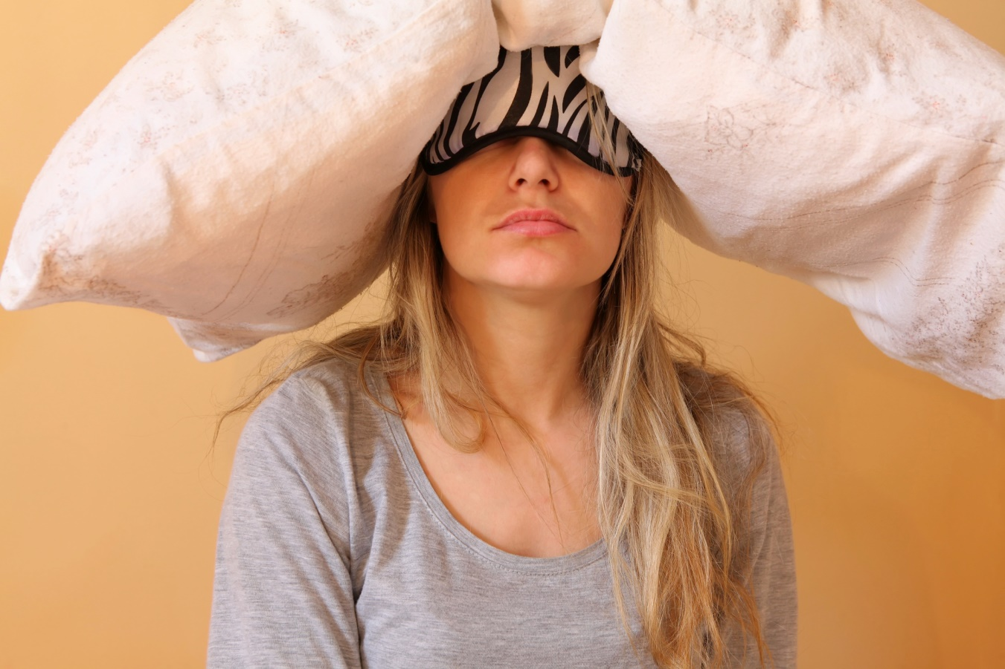
Draw Prizes

Slide 56
Famous Sleep Quotes
“A ruffled mind makes a restless pillow.”
  Charlotte Bronte
Don’t go to bed angry, you won’t sleep well. Stay up and fight!”
  Phyllis Diller

Slide 57
  Sleep Well Tonight!

Slide 58

Reflection
How do you deal with not sleeping well?
What worries you the most about not sleeping well?
What would be the most helpful thing to change in order to sleep better?
Why do you want to improve your sleep?

